Slide 1
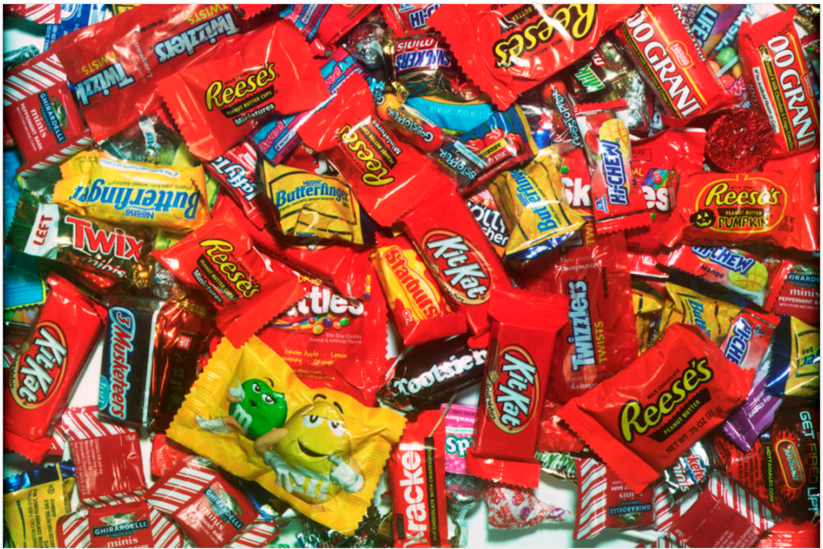
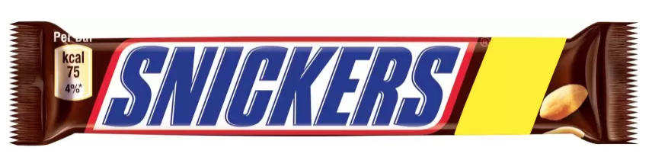
Candies
What makes them win!!!

Slide 2
What Makes candies win?
Predict winpercent of candies based on the available data set.
Use a machine learning algorithm to fit a model that can predict the winpercent.

Slide 3
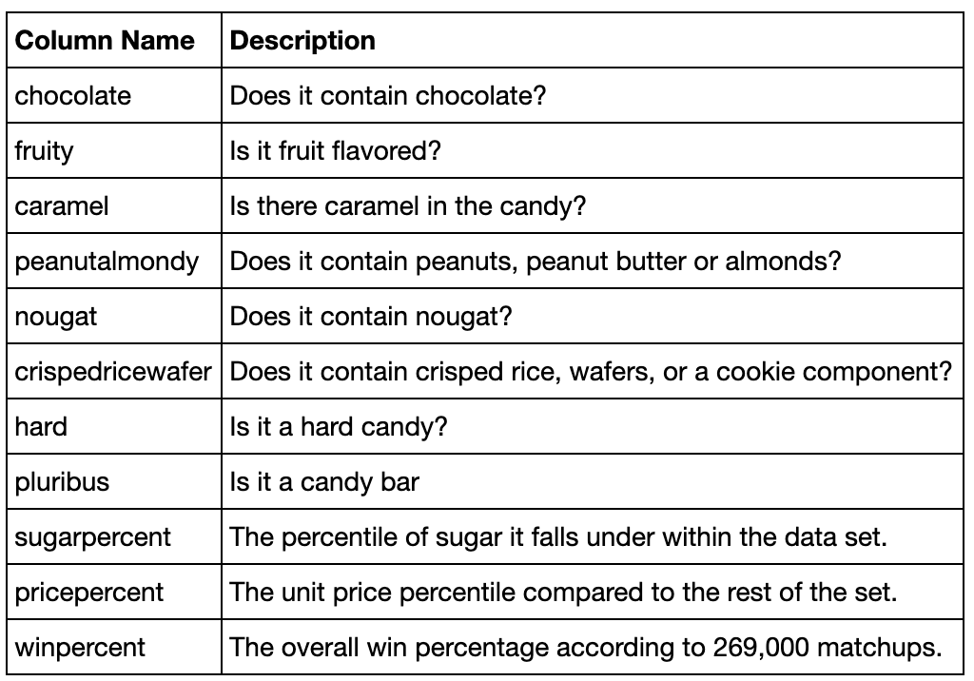
Data Set
The dataset comprises of 85 observations of 13 columns. Below is a table showing names of all the columns and their description.

Slide 4
Features and Target
There are 3 continues variables.
sugarpercent , pricepercent ,winpercent
There are 9 categorical dummy variables.
chocolate ,fruity ,caramel ,peanutyalmondy ,nougat ,crispedricewafer ,hard ,bar ,pluribus
There is 1 categorical text variable.
competitorname
The target variable to predict is winpercent

Slide 5
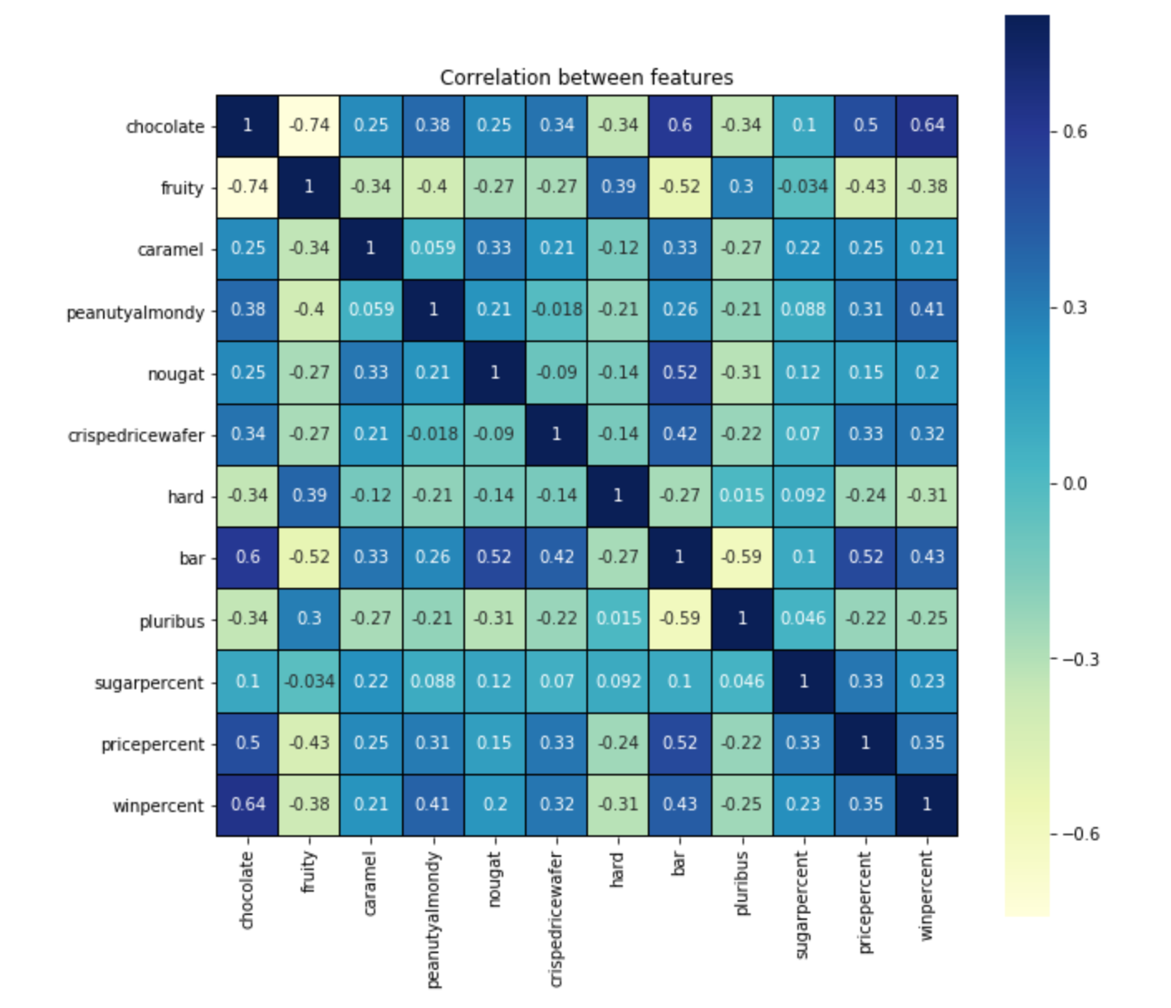
How are the features related?
Chocolate flavour and bar type it has higher correlation with winpercent.
If its chocolate flavour then it is most likely a bar.
Chocolate bar has higher pricepercent.
If it is Chocolate bar the chance of it being hard is unlikely. High Negative correlation.
If it is chocolate or bar, its not fruity.
If it is Fruity flavour winpercent goes down.
If it is Fruity flavour price goes down.
Caramel does not make much difference to winpercent.
peanutyalmondy has positive correlation with winprecent.
hard candies have negative correlation with winpercent.
pluribus does not make difference to winpercent.
pricepercent has little positive correlation with winpercent.

Slide 6
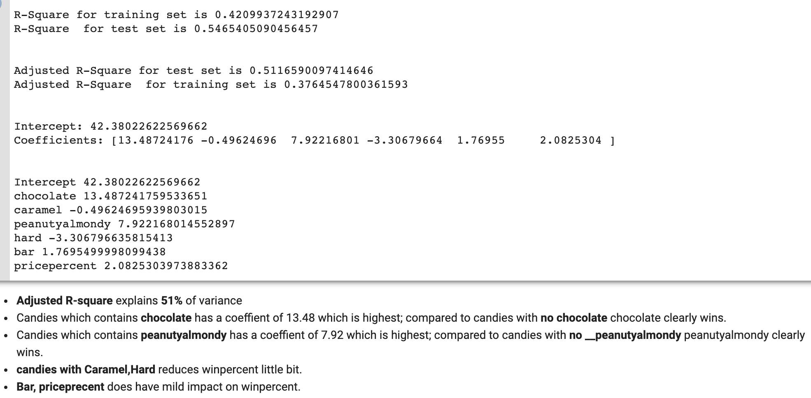
Linear regression I
The features competitorname, fruity, nougat, pluribus, sugarpercent, crispedricewafer have negligible influence on winpercent, hence ignoring them, the model results look as shown screen shot:

Slide 7
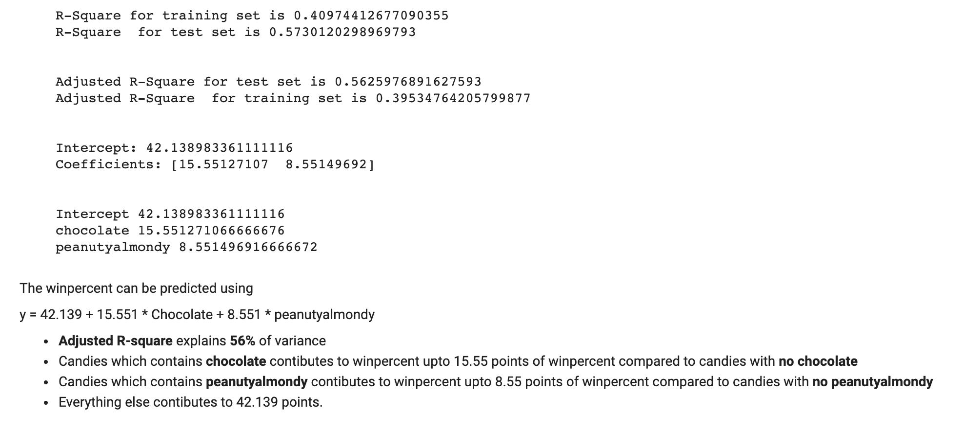
Linear regression ii
Predicting for only chocolate and peanutyalmondy, the model results look as shown screen shot:

Slide 8
No Wonder snickers rock!!!

